Slide 1

COMP 484 Web Engineering I
Instructor: ~kaplan (akaplan@csun.edu)
Supplemental Slides: Cascading Style Sheets (CSS)
part 2

Slide 2
Positioning Elements: Absolute
CSS position property
Allows absolute positioning
Normally, elements are positioned on the page in order in which they appear in HTML5 document
Specifying an element’s position as absolute removes it from the normal flow of elements
Positions it according to distance from the top, left, right or bottom margin of its parent element
CSS z-index property
Allows a developer to layer overlapping elements
Elements that have higher z-index values are displayed in front of elements with lower z-index values
© 2008 Pearson Education, Inc. All rights reserved.
Notes:
In front = closer to your eyes

Slide 3
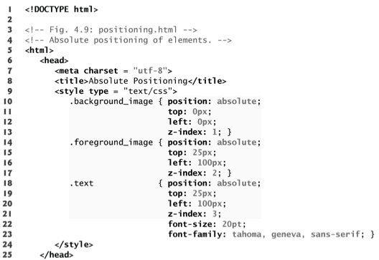
Class that sets an element’s position at top left of containing element
Lowest z-index is 1, so this element is behind all others
Set element’s position 25px from the top and 100px from left
This element will appear on top of .background_image since it has a higher z-index
This element will appear on top of all .background_image and .foreground_image
© 2008 Pearson Education, Inc. All rights reserved.

Slide 4
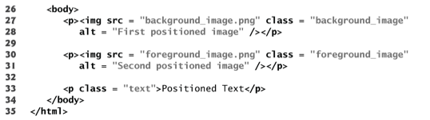


background_image.png
foreground_image.png
© 2008 Pearson Education, Inc. All rights reserved.

Slide 5
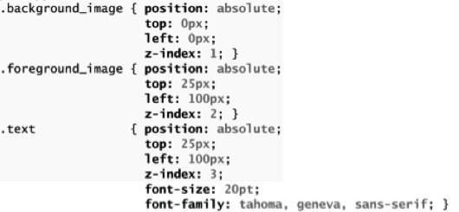
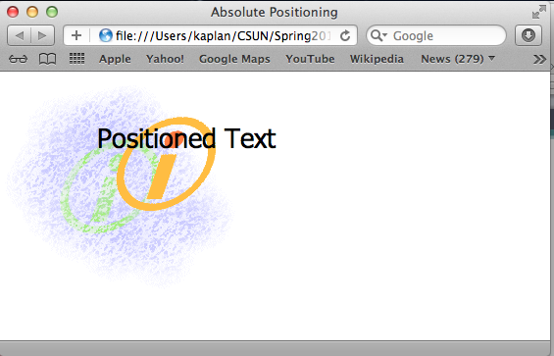
© 2008 Pearson Education, Inc. All rights reserved.

Slide 6
Positioning Elements: Relative
Relative positioning
Elements are positioned relative to their original position
Keeps elements in general flow on the page
Offsets them by specified top, left, right, or bottom values
© 2008 Pearson Education, Inc. All rights reserved.

Slide 7
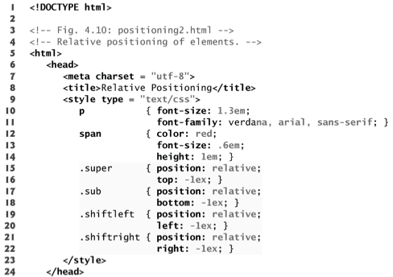
Position elements 1ex upwards
Position elements 1ex downwards
Position elements 1ex leftwards
Position elements 1ex rightwards
© 2008 Pearson Education, Inc. All rights reserved.
Notes:
What is ex again?
Size of lowercase x

Slide 8
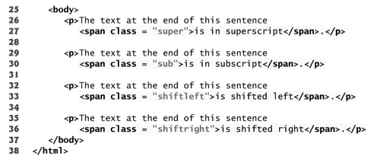
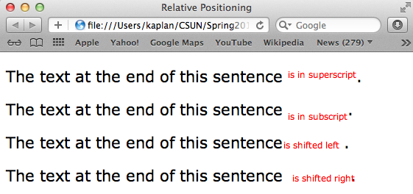
© 2008 Pearson Education, Inc. All rights reserved.
Notes:
Note…you can easily overlap text by mistake

Slide 9
Backgrounds
CSS can control the backgrounds of block-level elements by adding either colors or images
In the next example we will add a corporate logo to the bottom-right corner of a document
This logo stays fixed in the corner even when the user scrolls up or down
© 2008 Pearson Education, Inc. All rights reserved.

Slide 10
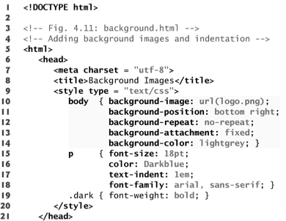
background-image Property
Specifies the URL of the image, in the format url(fileLocation)
background-position Property
Places the image on the page using the values top, bottom, center, left and right individually or in combination for vertical and horizontal positioning. You can also position by using lengths
background-repeat Property
Controls the tiling of the background image
Setting the tiling to no-repeat displays one copy of the background image on screen
Setting to repeat (the default) tiles the image vertically and horizontally
Setting to repeat-x tiles the image only horizontally
Setting to repeat-y tile the image only vertically
© 2008 Pearson Education, Inc. All rights reserved.

Slide 11
background-attachment Property
scroll (the default value) moves the image as the user scrolls the window
fixed fixes the image in the position specified by background-position
scrolling the browser window will not move the image from its position
text-indent Property
Indents the first line of text in the element by the specified amount
© 2008 Pearson Education, Inc. All rights reserved.

Slide 12
Inserts the image logo.png as the background
Places the image at the bottom right of the page
Displays only one copy of the image
Keeps image in place when user scrolls
Fills remainder of window with lightgrey background
Indents the 1st line of text in the paragraph by 1em
© 2008 Pearson Education, Inc. All rights reserved.

Slide 13
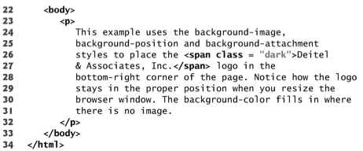
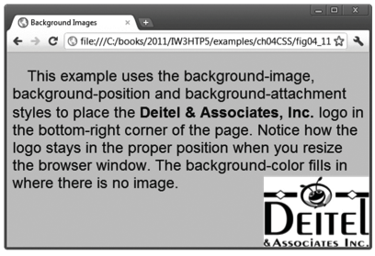
© 2008 Pearson Education, Inc. All rights reserved.

Slide 14
Element Dimensions
width and height Properties
Sets dimensions of elements on a page
Their values can be relative or absolute
width: x% sets width of element to x% of containing block’s width
text-align Property
Text in an element can be centered using
text-align: center
Text can also be aligned left or right
overflow Property
Can set the overflow property to scroll
Adds scroll bars if the text overflows the boundaries set for it
© 2008 Pearson Education, Inc. All rights reserved.
Notes:
visible The overflow is not clipped. It renders outside the element's box. This is default
hidden The overflow is clipped, and the rest of the content will be invisible
scroll The overflow is clipped, but a scroll-bar is added to see the rest of the content
auto If overflow is clipped, a scroll-bar should be added to see the rest of the content
inherit Specifies that the value of the overflow property should be inherited from the parent element
“If no hard constraints are imposed by other properties, the element is allowed to assume its natural content width, based on the width of the horizontal space available. For static or (relatively positioned) elements, this means that an element whose width is set to auto will expand to fill the parent without our needing to set a specific width such as width:100%. “

Slide 15
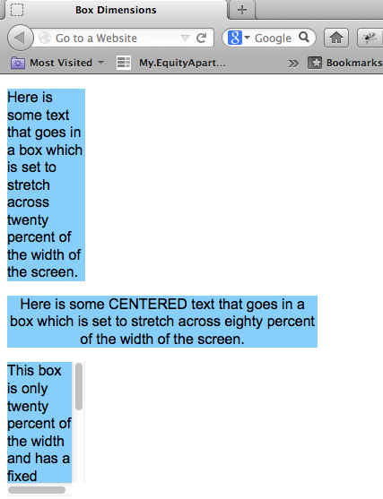
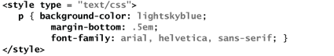
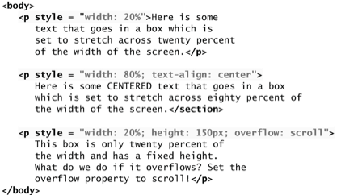
© 2008 Pearson Education, Inc. All rights reserved.

Slide 16
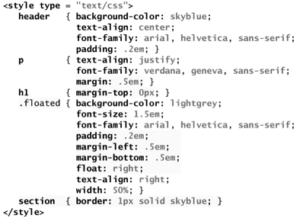
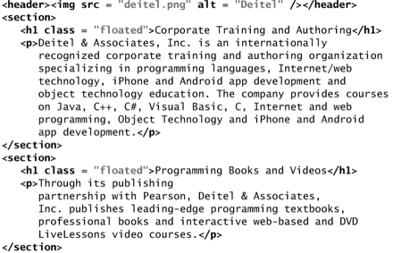

© 2008 Pearson Education, Inc. All rights reserved.
Floating Elements
Floating allows you to move an element to one side of the screen;
Other content in the document then flows around the floated element
Notes:
Text-align: justify
Stretches the lines so that each line has equal width (like in newspapers and magazines)

Slide 17
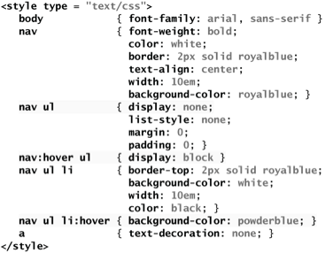
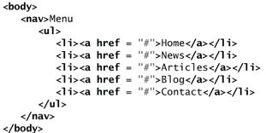
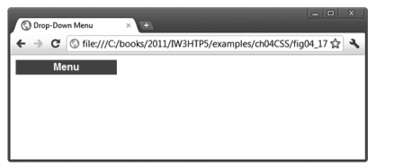
Custom Drop-Down Menu
display property
allows a programmer to decide if an element is displayed as a block element, inline element, or is not rendered at all (none)
© 2008 Pearson Education, Inc. All rights reserved.
Notes:
:hover pseudoclass
used to apply styles to an element when the mouse cursor is over it
So here the menu is collapsed, since there is no hovering

Slide 18
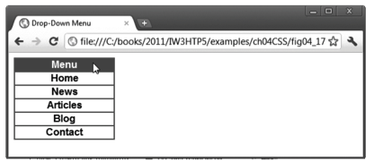
Custom Drop-Down Menu
display property
allows a programmer to decide if an element is displayed as a block element, inline element, or is not rendered at all (none)
© 2008 Pearson Education, Inc. All rights reserved.
Notes:
When you hover over the nav its nested ul changes display from none to block

Slide 19
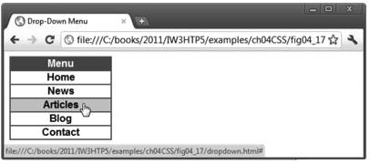
Custom Drop-Down Menu
display property
allows a programmer to decide if an element is displayed as a block element, inline element, or is not rendered at all (none)
© 2008 Pearson Education, Inc. All rights reserved.
Notes:
When you hover over a list item in an unordered list in a nav, its background turns powder-blue and its text is undecorated

Slide 20
Descendents vs Children
Example:
h1 { color: red }
em { color: red }
h1 em { color: blue }
<h1>This <span class="myclass">headline is <em>very</em> important</span></h1>
blue
Will “very” be or red ?
Why: the syntax says that em is a descendent of h1.
(Need not be an immediate child!)

Slide 21
Descendents vs Children
Example:
h1 { color: red }
em { color: red }
h1 > em { color: blue }
<h1>This <span class="myclass">headline is <em>very</em> important</span></h1>
blue
red
Will “very” be or ?
Why: the syntax says that em must be a direct child of h1 to be blue.

Slide 22
What about these…?
Example:
body > p { line-height: 1.3 }
Example:
div ol>li p
Sets the line height to 1.3x the current font size for any paragraphs that are direct children of the body…i.e. top-level paragraphs
Matches paragraphs that are descendents of list items that are direct children of an ordered list that are descendents of a div

Slide 23
Adjacent Sibling Selectors
E1 + E2 matches the case where E1 element immediately precedes an E2 element
They are siblings
Example:
h1 + h2 { margin-top: -5mm }
reduces the vertical space between any h1 and h2 that are immediate siblings
Reduces the top margin on the h2 element

Slide 24
The Universal Selector
The famous * character is CSS’s universal selector
Around since CSS2
Applies a CSS rule to any element type
Some types elements may ignore the rules you specify
If the rules do not apply
Example:
div * em { /* Question: Which <em>s does this apply to? */ }
<body>
<div>
<h1>The <em>Universal</em> Selector</h1>
<p>We must <em>emphasize</em> the following:</p>
<ul>
<li>It's <em>not</em> a wildcard.</li>
<li>It matches elements regardless of <em>type</em>.</li>
</ul>
This is an <em>immediate</em> child of the division.
</div>
</body>
Notes:
“Universal” in the h1 element (* matches the <h1>)
“emphasize” in the p element (* matches the <p>)
“not” in the first li element (* matches the <ul> or the <li>)
“type” in the second li element (* matches the <ul> or the <li>)
However, it won’t match the
<em>immediate</em> element,
since that’s an immediate child of the div element—there’s nothing between <div> and <em> for the * to match.

Slide 25
What about these…?
Example:
* { margin: 0; padding: 0 }
Example:
* html { color: red }
Example:
div p *[href] { /* ? */ }
Example:
*:hover { background-color:yellow }
Matches all elements on the page!
Matches no element…html is never a descendent of any other element!
Matches any element with the href attribute set, which is located inside a paragraph inside a div
Doesn’t work like you might think…some elements should NOT change when hovered…specify them in their own hover rules.

